Slide 1
Using Github with Netbeans
How to turn a project into a repository

Slide 2


Pre-Project checklist
These few things need to be done before you can start
Make sure you have the newest version of netbeans (8.0.2) at this moment, and have a github account

Slide 3
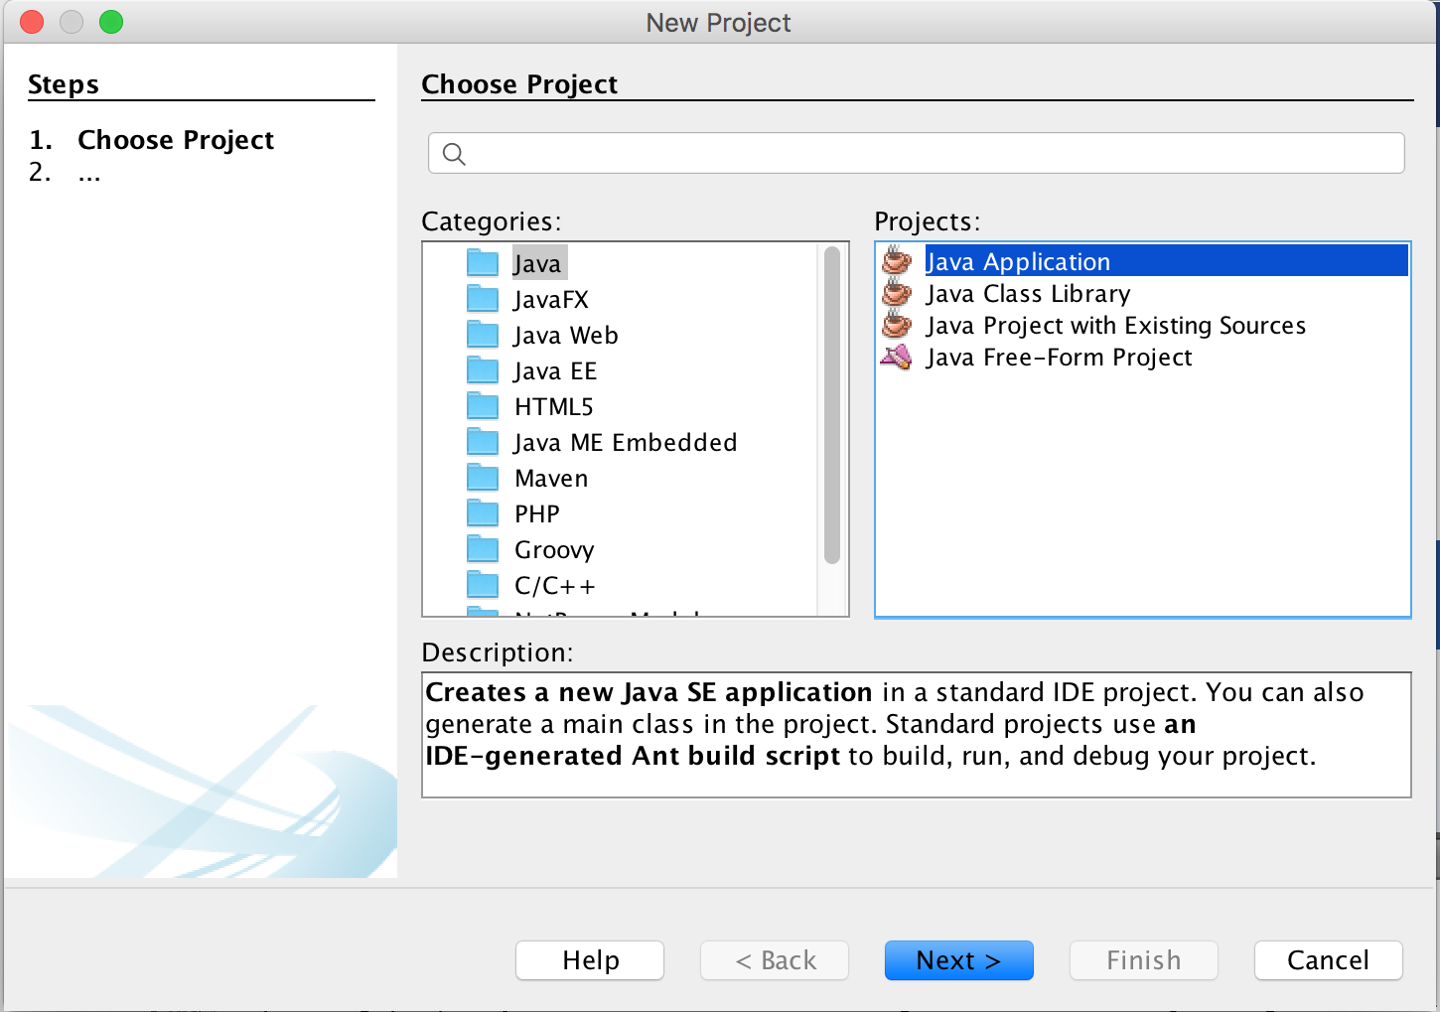
Turn your project into a repository
Open up Netbeans and create a new project
Name that program accordingly as it cant be changed later

Slide 4
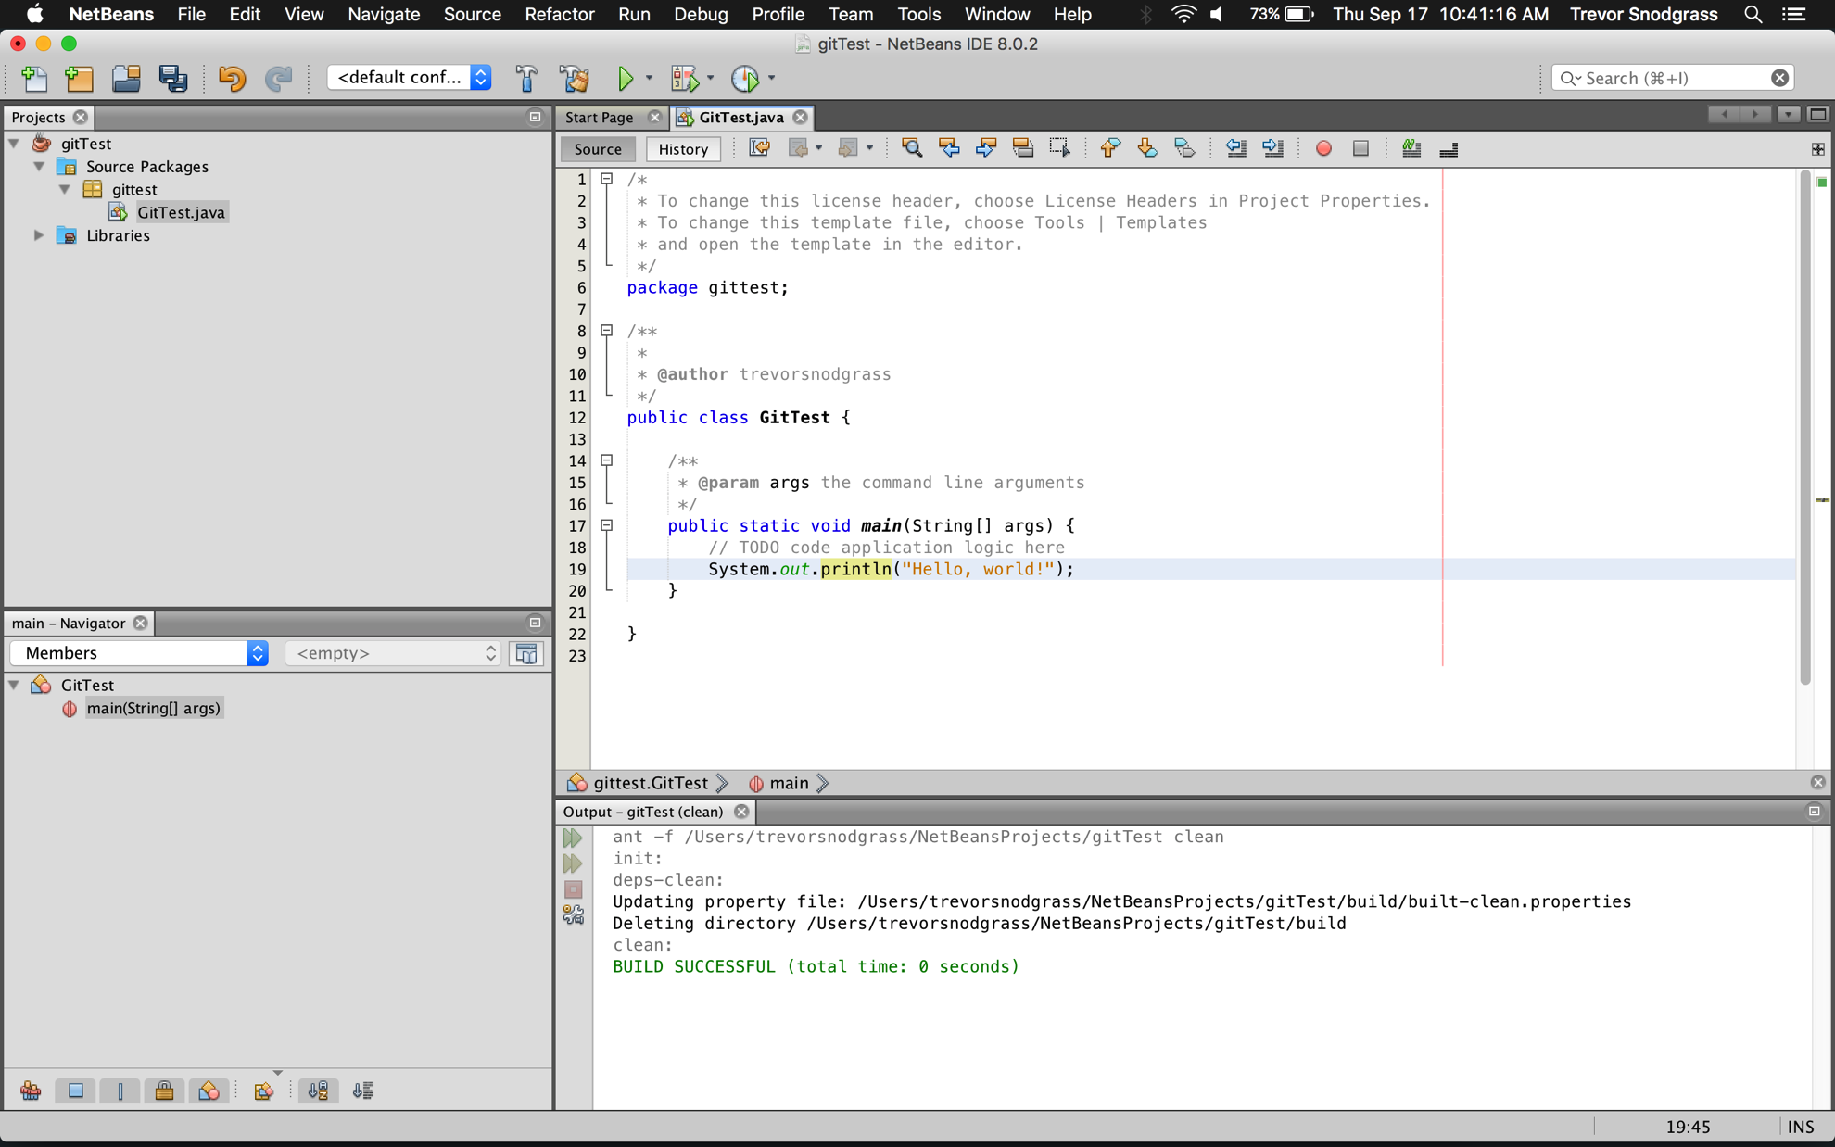
Turn your project into a repository
Make some sort of program (no need to upload a blank file)
Make sure you save before continuing

Slide 5
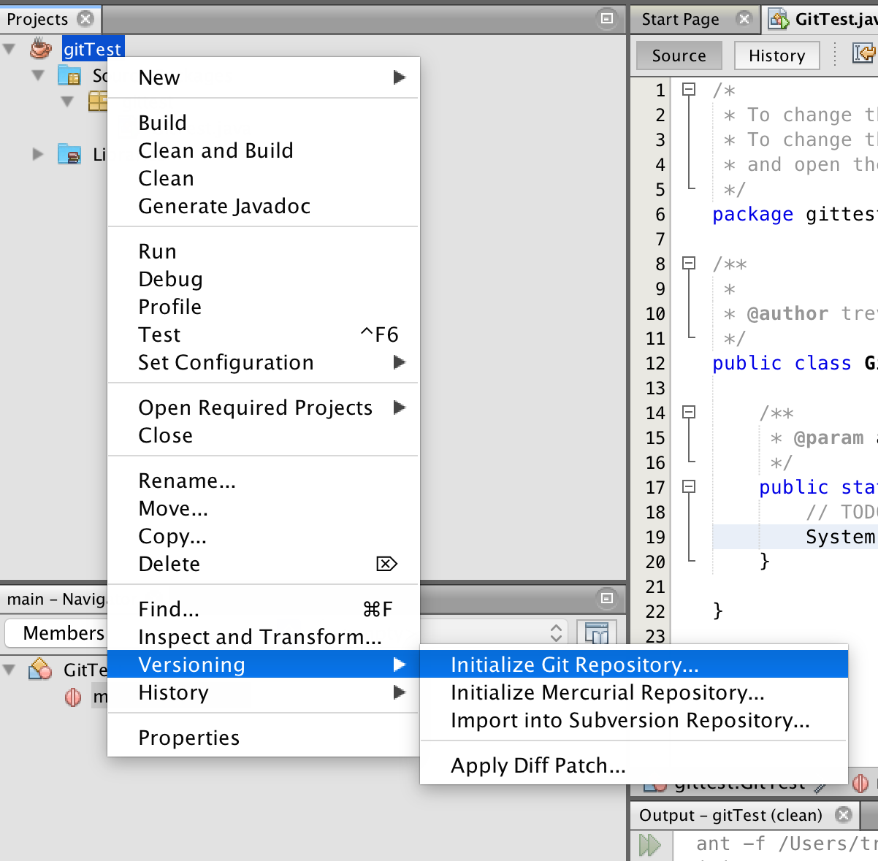
Turn your project into a repository
Right click on your project in the sidebar and select “Versioning” and then “Initialize Git Repository”
Just click OK on the next prompt

Slide 6
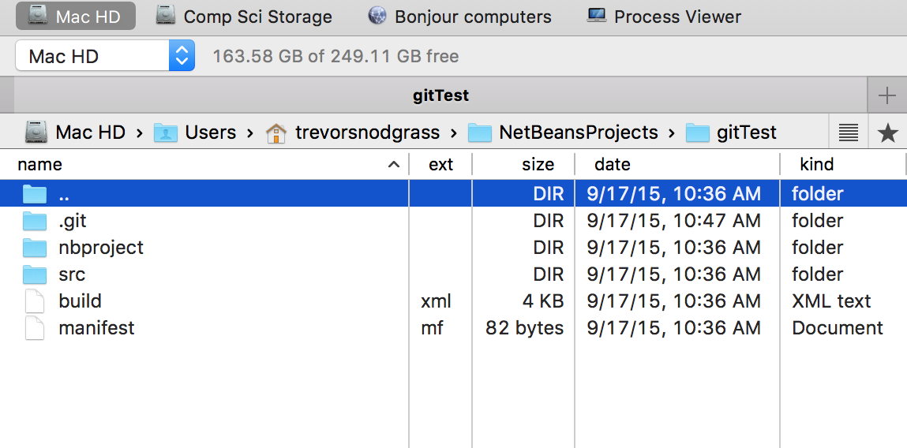
What does this do?
Creating a Git repository allows for your program to keep track of changes and adds a .git subfolder

Slide 7
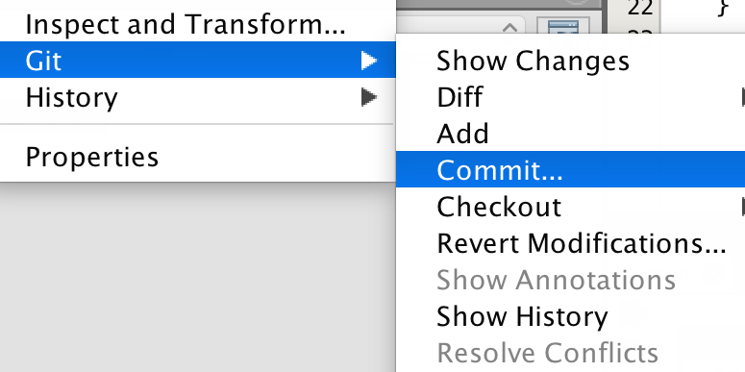
Committing to your repository
Right click on your project again and select “Git” and “Commit”
This adds your changes to the git log

Slide 8

Uploading to Github
This is the fun part

Slide 9
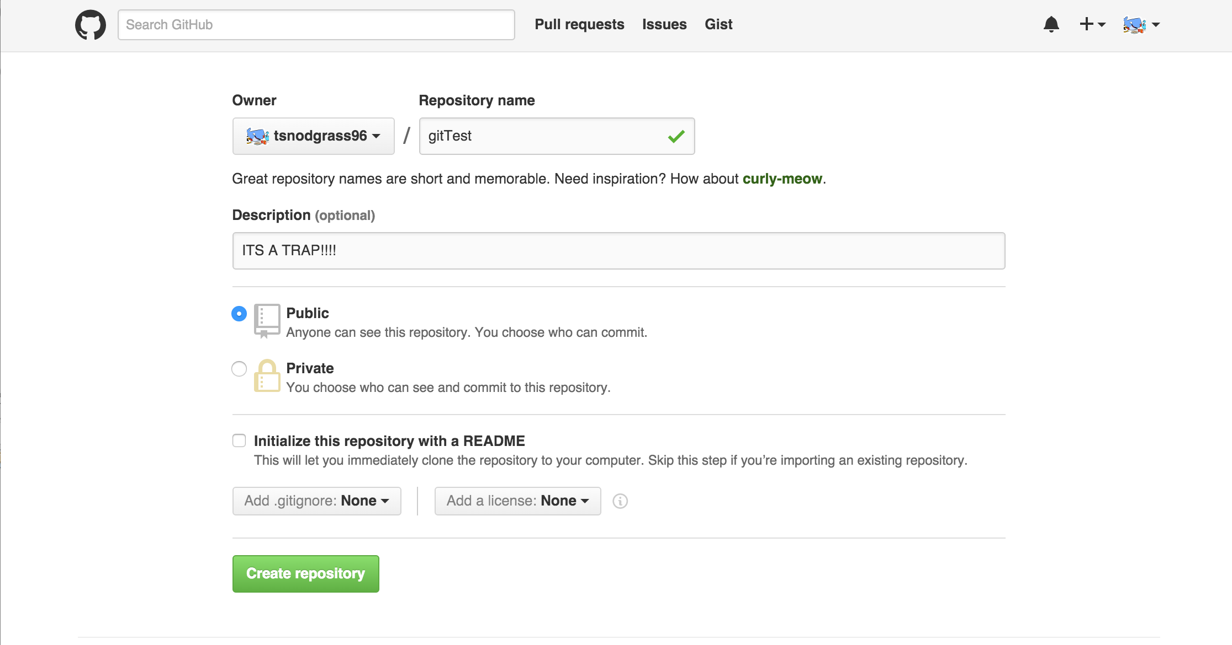
Create your new “repo”
To create a github repository do the following:
Click the plus sign and select create new repository
Give the repository the same name as your program

Slide 10
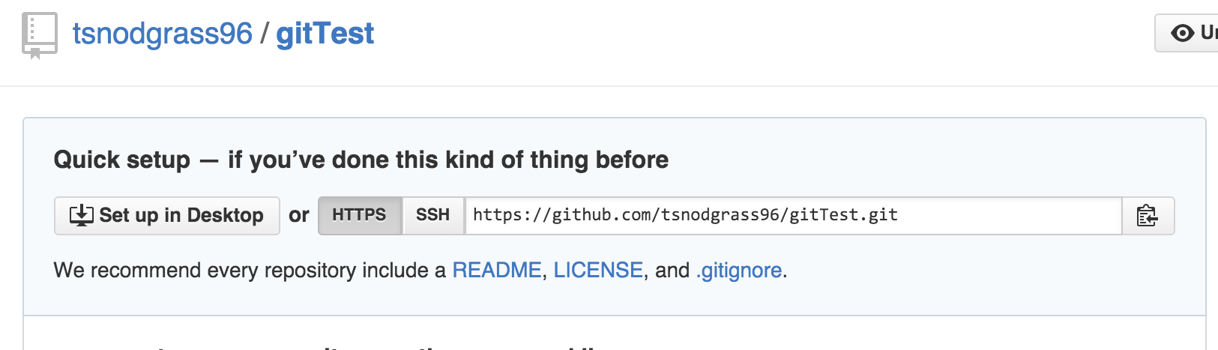
Create your new “repo”
To create a github repository do the following:
Copy the HTTPS key it gives you and then move back on over to netbeans (eventually you wont even need to copy it, you can just type it)

Slide 11
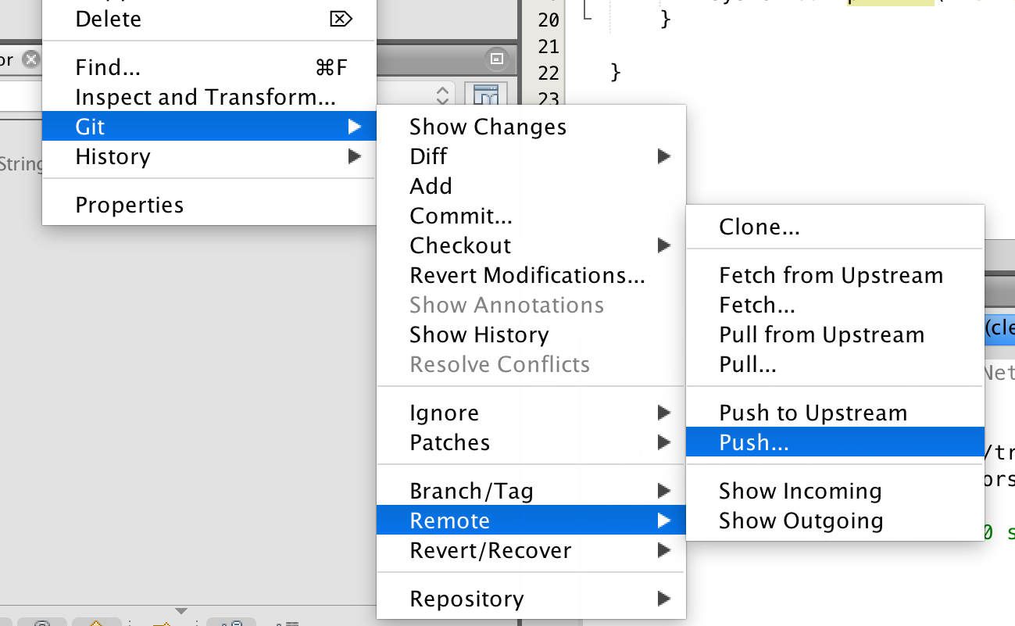
Connecting to Netbeans
Right click on the project name and select “Git”, “Remote” and then “Push”
Paste the URL you copied and then enter your Github info, and use the default branch (Master)

Slide 12
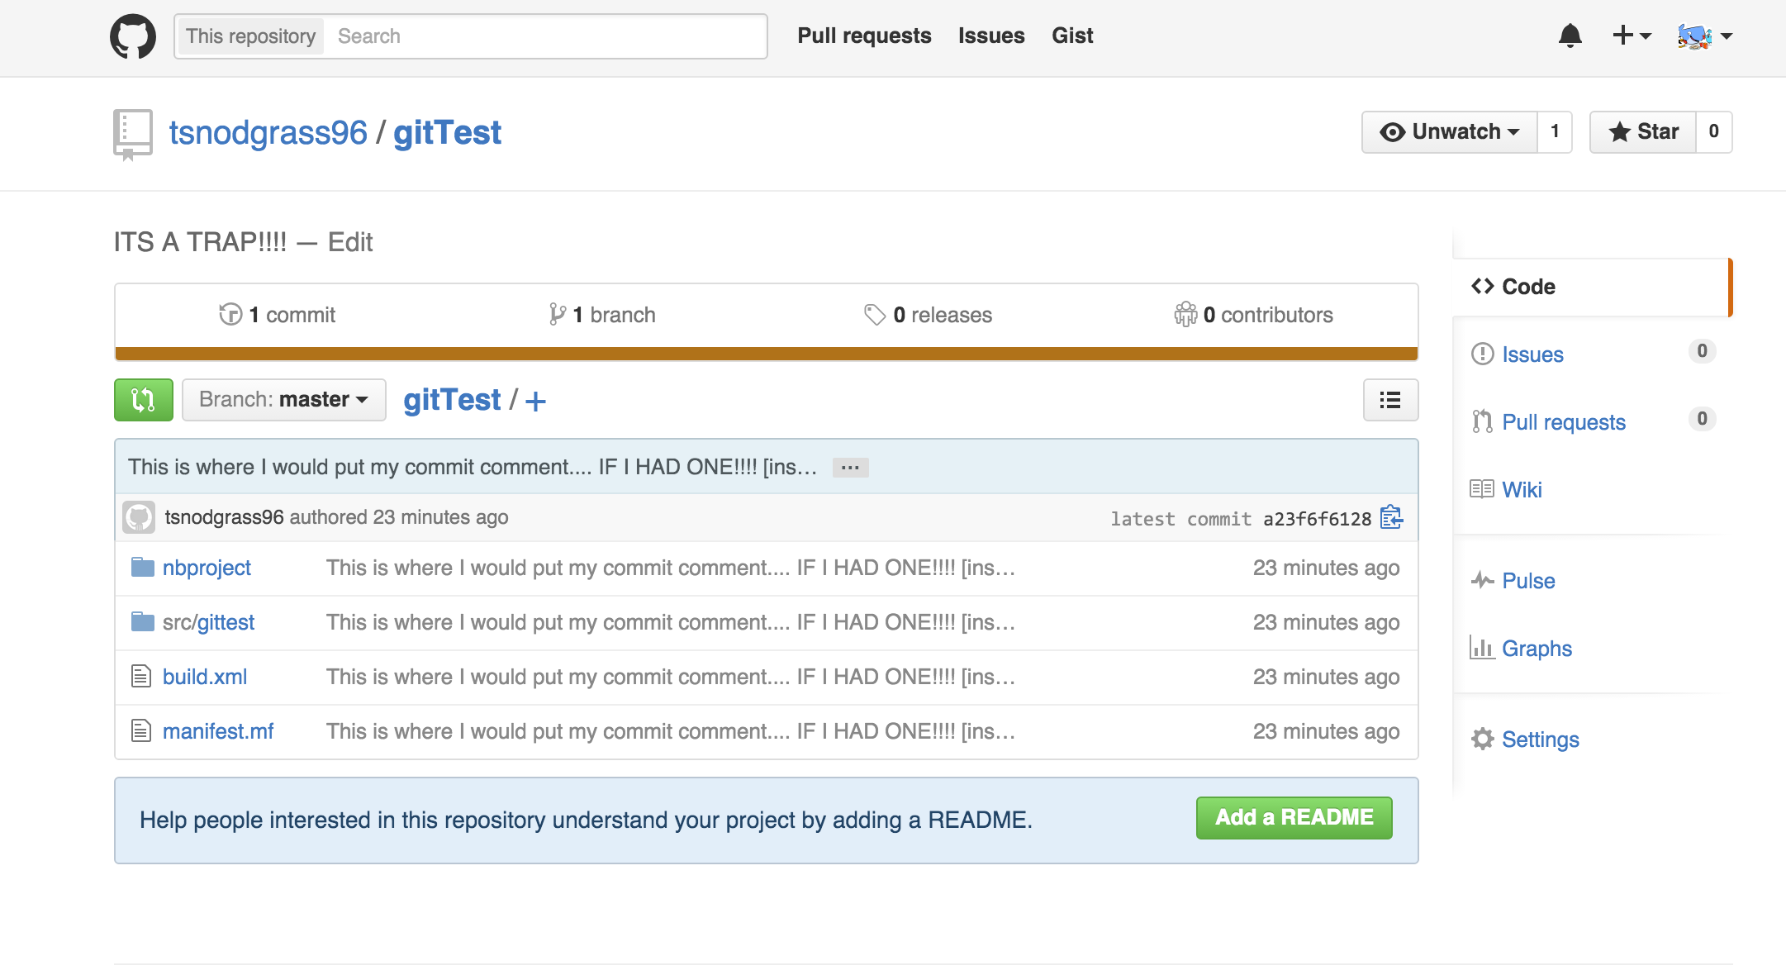
Move on back over to Github
Refresh the page for your brand new shiny repo and magically there is new stuff and files!!!
This is actually your full project and can be downloaded and opened in netbeans

Slide 13
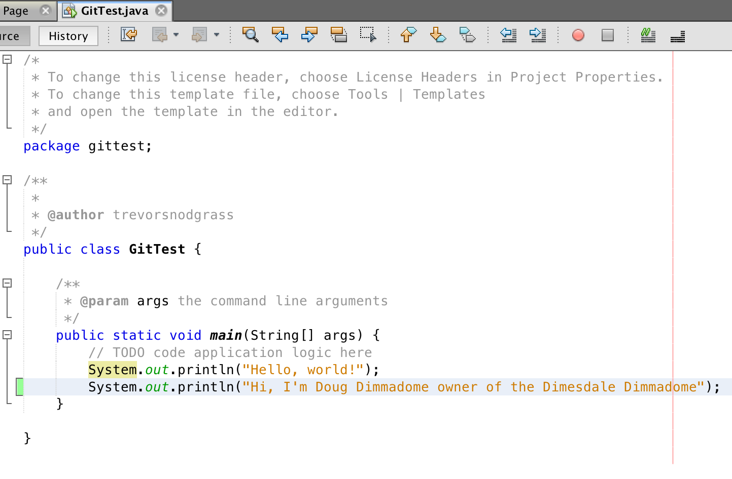
Future Program Updates
No program doesn’t go without being changed over time and updating Github is pretty easy
Make some sort of changes to your program
This will add a great tag surrounding the lines that you have added (red indicated removed)

Slide 14
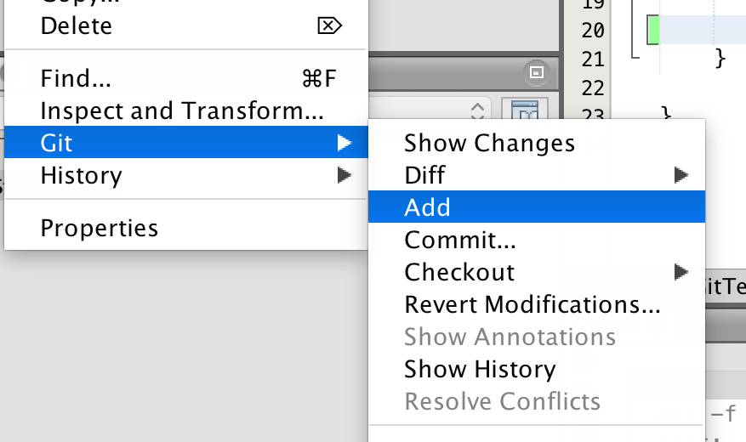
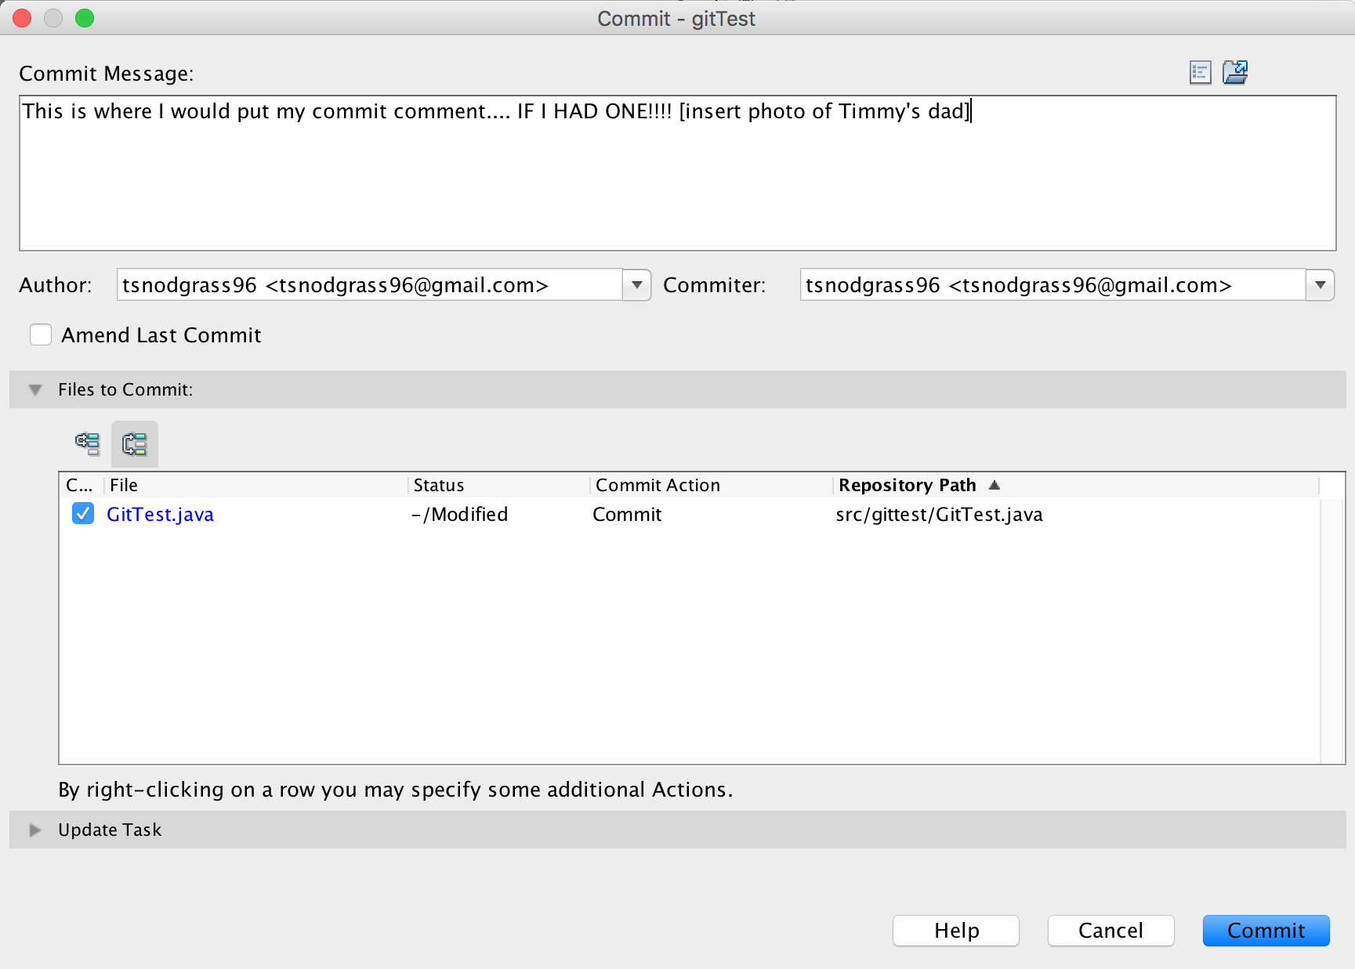
Future Program Updates
Right Click on your program name and select “Git” “Add” (this will make your file names turn blue meaning they need to be committed) then “Git” “Commit” and add a message
Finally right click and select “Git” “Remote” “Push” and do the same process as before

Slide 15
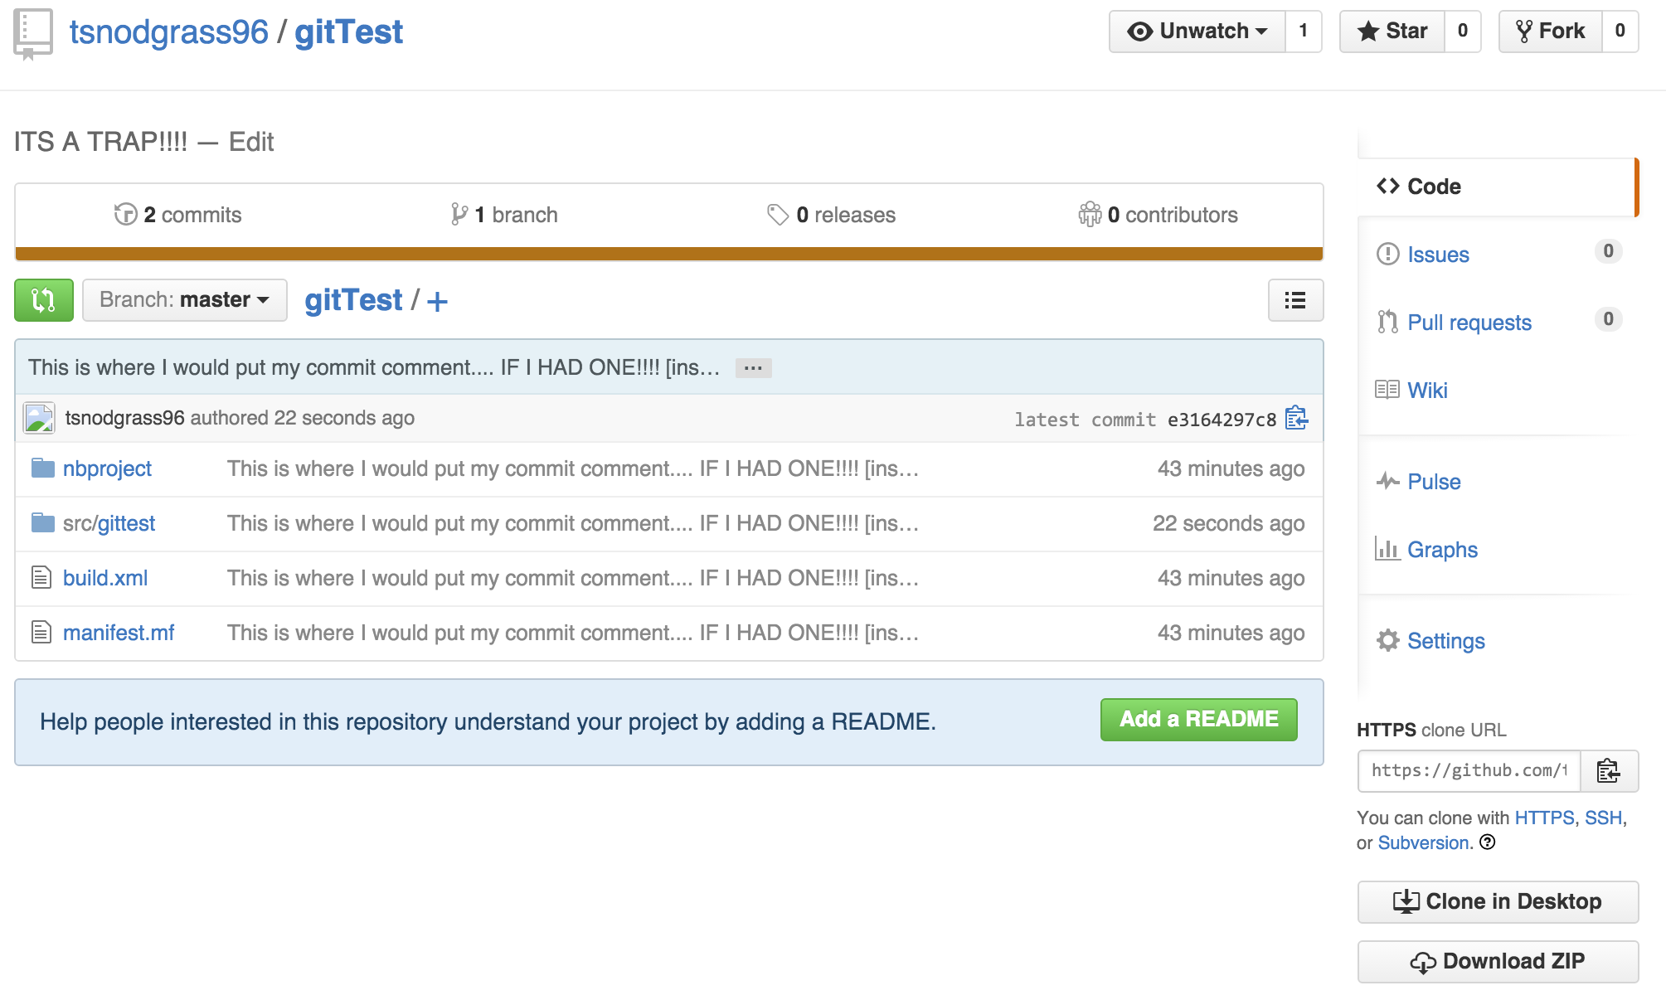
Confirmation it is on Github
Move back over to Github and refresh the page.
You will see that the /src folder had been updated with a new time stamp and the file itself has actually been updated

Slide 16

This is where I would put my copyright…. IF I HAD ONE!!!!

